Slide 1
Module 2: Computer-System Structures
Computer System Operation
I/O Structure
Storage Structure
Storage Hierarchy
Hardware Protection
General System Architecture

Slide 2
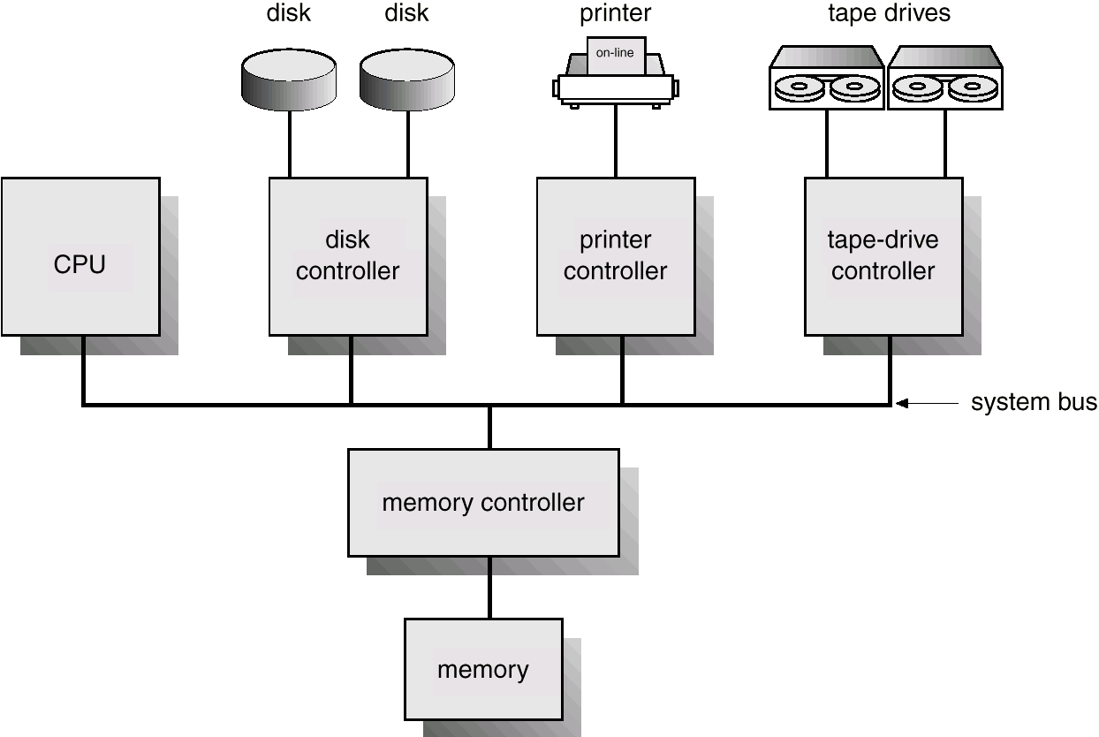
Computer-System Architecture

Slide 3
Computer-System Operation
I/O devices and the CPU can execute concurrently.
Each device controller has a local buffer.
CPU moves data from/to main memory to/from local buffers
I/O is from the device to local buffer of controller.
Device controller informs CPU that it has finished its operation by causing an interrupt.

Slide 4
Common Functions of Interrupts
Interrupts transfers control to the interrupt service routine generally, through the interrupt vector, which contains the addresses of all the service routines.
Interrupt architecture must save the address of the interrupted instruction.
Incoming interrupts are disabled while another interrupt is being processed to prevent a lost interrupt.
A trap is a software-generated interrupt caused either by an error or a user request.
An operating system is interrupt driven.

Slide 5
Interrupt Handling
The operating system preserves the state of the CPU by storing registers and the program counter.
Determines which type of interrupt has occurred:
  polling
  vectored interrupt system
Separate segments of code determine what action should be taken for each type of interrupt

Slide 6
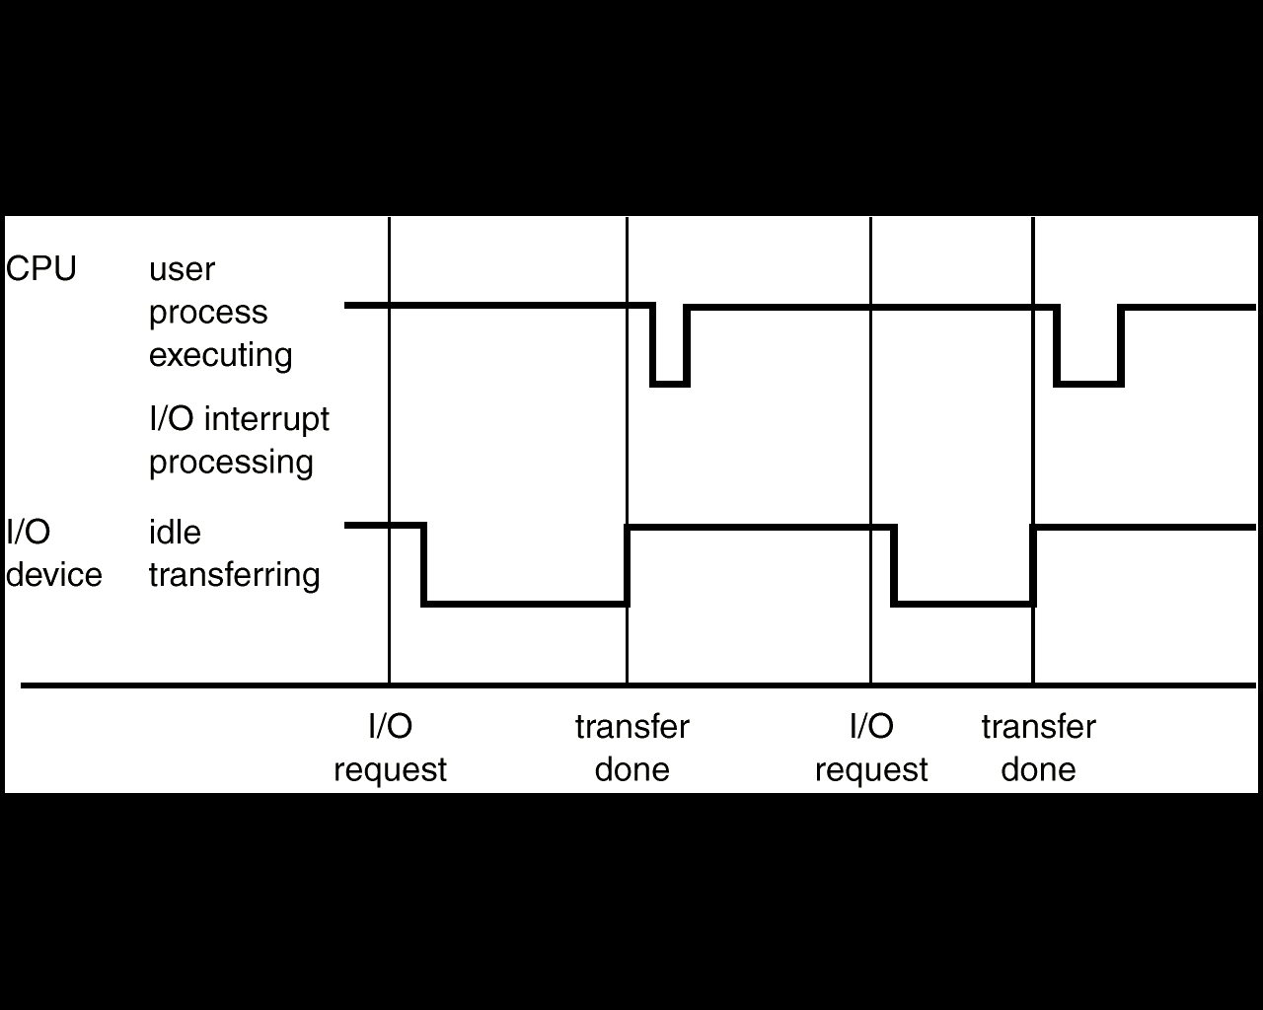
Interrupt Time Line For a Single Process Doing Output

Slide 7
I/O Structure
After I/O starts, control returns to user program only upon I/O completion.
  wait instruction idles the CPU until the next interrupt
  wait loop (contention for memory access).
  At most one I/O request is outstanding at a time, no simultaneous I/O processing.
After I/O starts, control returns to user program without waiting for I/O completion.
  System call – request to the operating system to allow user to wait for I/O completion.
  Device-status table contains entry for each I/O device indicating its type, address, and state.
  Operating system indexes into I/O device table to determine device status and to modify table entry to include interrupt.

Slide 8
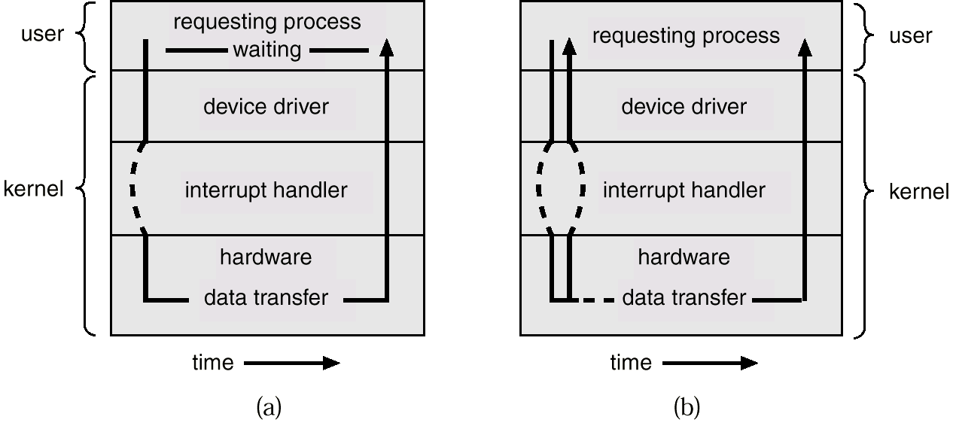
Two I/O methods
Synchronous
Asynchronous

Slide 9
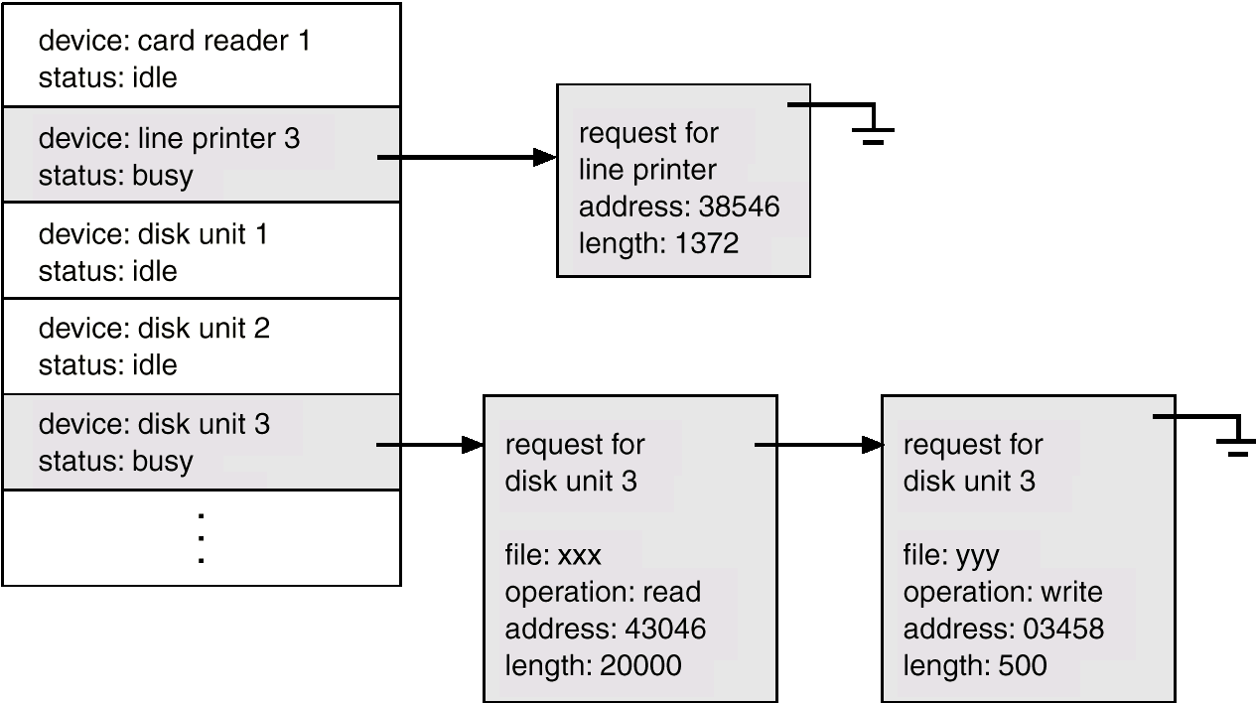
Device-Status Table

Slide 10
Direct Memory Access (DMA) Structure
Used for high-speed I/O devices able to transmit information at close to memory speeds.
Device controller transfers blocks of data from buffer storage directly to main memory without CPU intervention.
Only one interrupt is generated per block, rather than the one interrupt per byte.
Def: Direct memory access (DMA) is a feature of computer systems that allows certain hardware subsystems to access main system memory (RAM), independent of the central processing unit (CPU).

Slide 11
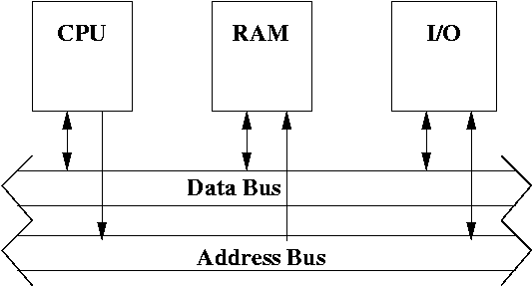
The basic computer
Steps involved in storing data to the memory by the I/O device:
CPU signals I/O device
I/O places data on the bus and signals to CPU
CPU reads the data into a register and signals to I/O
CPU signals memory
Memory writes data to some location
Memory signals CPU that it is done.
Notes:
The early model of a computer has the CPU in control of the bus. Thus if the I/O device wants to write or read from memory then it has to go through the CPU.

Slide 12
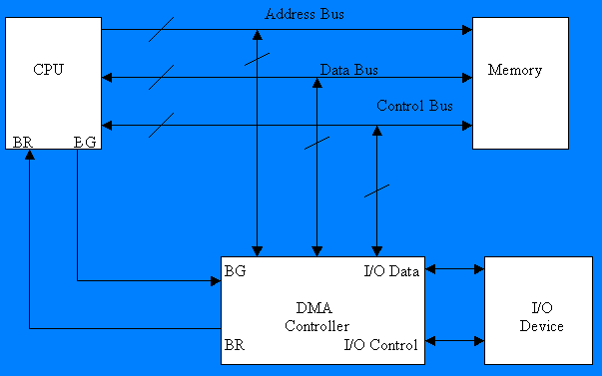
Computer System with DMA

Slide 13
Working
Consider a typical system consisting of a CPU ,memory and one or more input/output devices as shown in fig. Assume one of the I/O devices is a disk and that the computer must load a program from this drive into memory.
The CPU would read the first byte of the program and then write that byte to memory. Then it would do the same for the second byte, until it had loaded the entire program into memory.

Slide 14
This process proves to be inefficient. Loading data into, and then writing data out of the CPU significantly slows down the transfer. The CPU does not modify the data at all, so it only serves as an additional stop for data on the way to it’s final destination.
The process would be much quicker if we could bypass the CPU & transfer data directly from the I/O device to memory.
Direct Memory Access does exactly that.

Slide 15
Implementing DMA in a Computer System
A DMA controller implements direct memory access in a computer system.
It connects directly to the I/O device at one end and to the system buses at the other end. It also interacts with the CPU, both via the system buses and two new direct connections.
It is sometimes referred to as a channel. In an alternate configuration, the DMA controller may be incorporated directly into the I/O device.

Slide 16
Data Transfer using DMA Controller
To transfer data from an I/O device to memory, the DMA controller first sends a Bus Request to the CPU by setting BR to 1. When it is ready to grant this request, the CPU sets it’s Bus grant signal, BG to 1.
The CPU also tri-states it’s address,data, and control lines thus truly granting control of the system buses to the DMA controller.
The CPU will continue to tri-state it’s outputs as long as BR is declare.

Slide 17
Storage Structure
Main memory – only large storage media that the CPU can access directly.
Secondary storage – extension of main memory that provides large nonvolatile storage capacity.
Magnetic disks – rigid metal or glass platters covered with magnetic recording material
  Disk surface is logically divided into tracks, which are subdivided into sectors.
  The disk controller determines the logical interaction between the device and the computer.

Slide 18
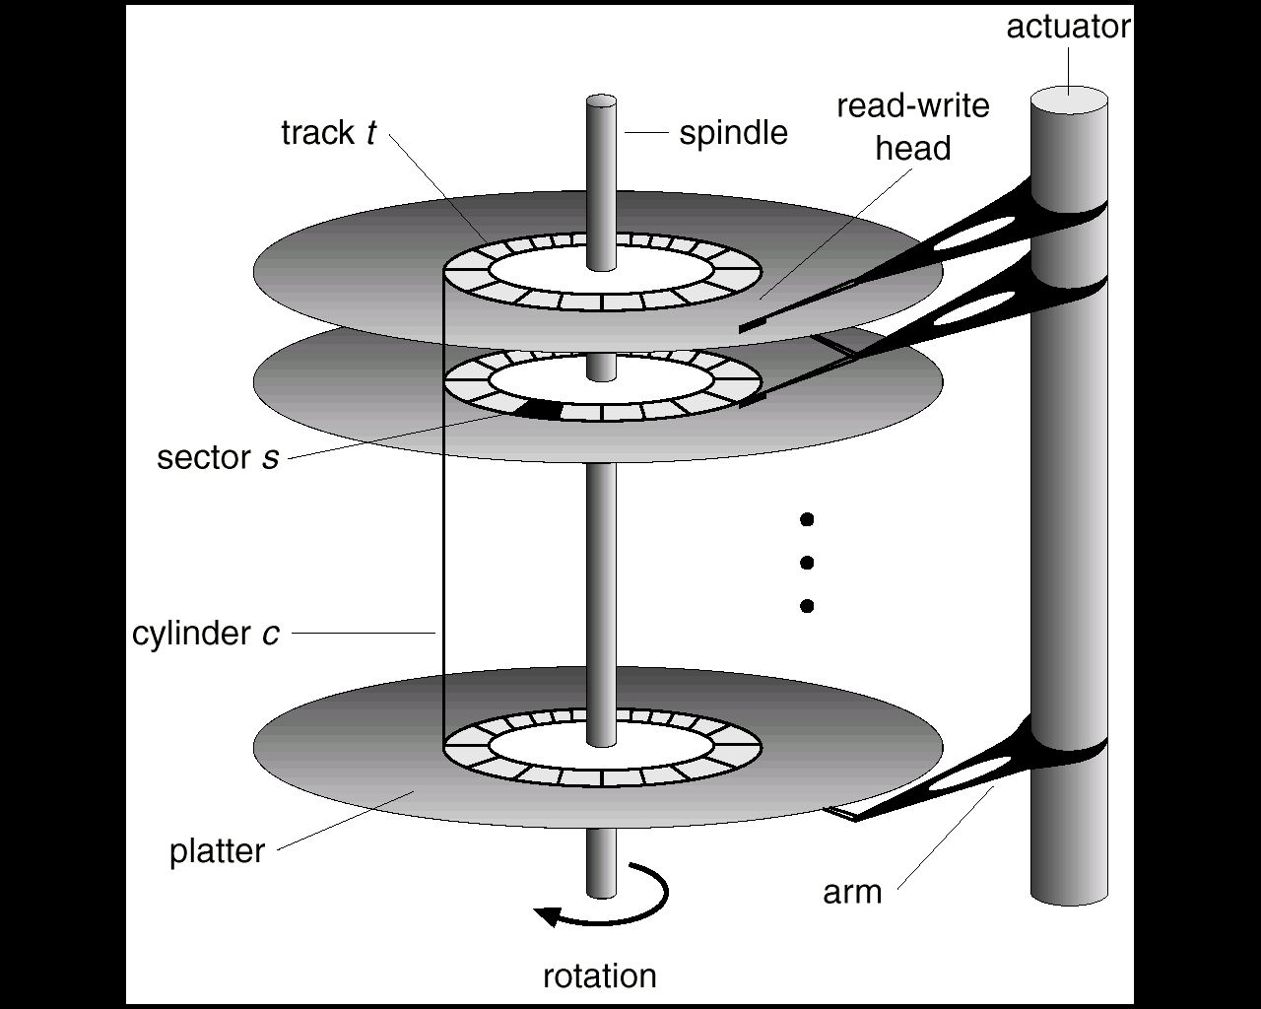
Moving-Head Disk Mechanism(Magnetic Disk)

Slide 19
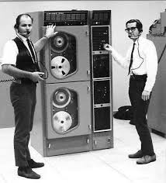
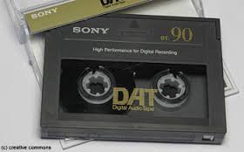
Magnetic Tapes

Slide 20
Storage Hierarchy
Storage systems organized in hierarchy.
  Speed
  cost
  volatility
Caching – copying information into faster storage system; main memory can be viewed as a last cache for secondary storage.

Slide 21
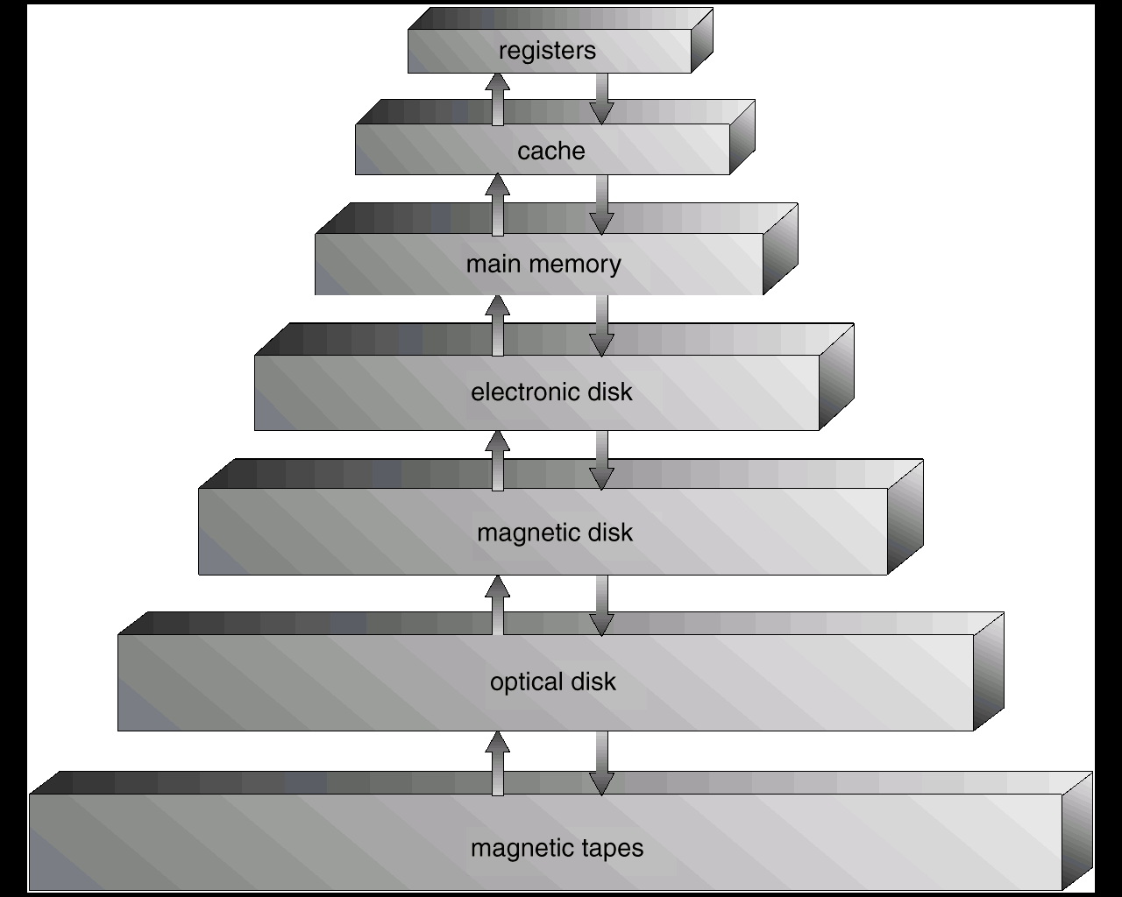
Storage-Device Hierarchy

Slide 22
Hardware Protection
Dual-Mode Operation
I/O Protection
Memory Protection
CPU Protection

Slide 23
Dual-Mode Operation
Sharing system resources requires operating system to ensure that an incorrect program cannot cause other programs to execute incorrectly.
Provide hardware support to differentiate between at least two modes of operations.
  1. User mode – execution done on behalf of a user.
  2. Monitor mode (also supervisor mode or system mode) – execution done on behalf of operating system.

Slide 24
Dual-Mode Operation (Cont.)
Mode bit added to computer hardware to indicate the current mode: monitor (0) or user (1).
When an interrupt or fault occurs hardware switches to monitor mode.
Interrupt/fault
monitor
user
set user mode
Privileged instructions can be issued only in monitor mode.

Slide 25
I/O Protection
All I/O instructions are privileged instructions.
Must ensure that a user program could never gain control of the computer in monitor mode (I.e., a user program that, as part of its execution, stores a new address in the interrupt vector).

Slide 26
Memory Protection
Must provide memory protection at least for the interrupt vector and the interrupt service routines.
In order to have memory protection, add two registers that determine the range of legal addresses a program may access:
  base register – holds the smallest legal physical memory address.
  Limit register – contains the size of the range
Memory outside the defined range is protected.

Slide 27
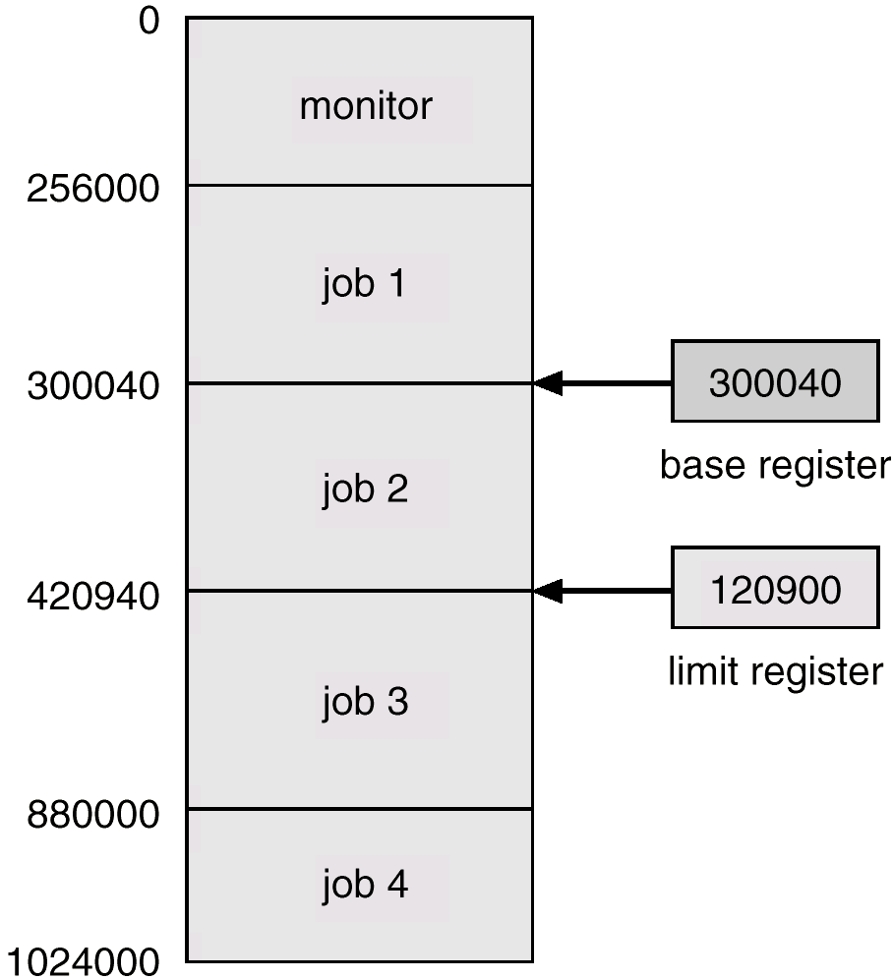
A Base And A limit Register Define A Logical Address Space

Slide 28
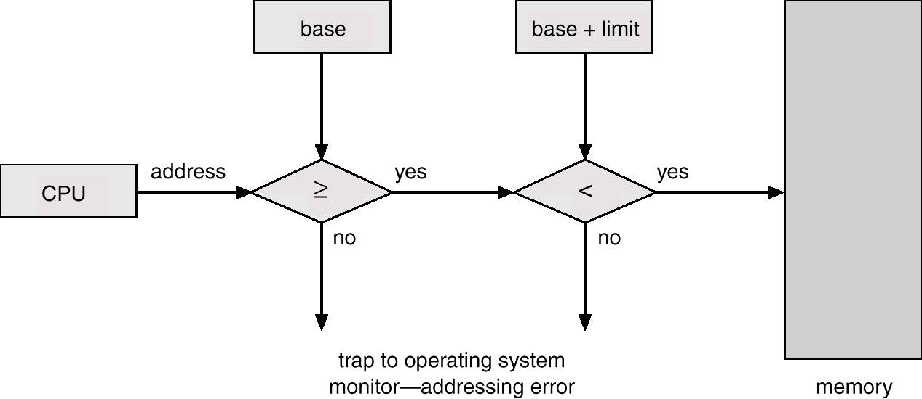
Protection Hardware
When executing in monitor mode, the operating system has unrestricted access to both monitor and user’s memory.
The load instructions for the base and limit registers are privileged instructions.

Slide 29
CPU Protection
Timer – interrupts computer after specified period to ensure operating system maintains control.
  Timer is decremented every clock tick.
  When timer reaches the value 0, an interrupt occurs.
Timer commonly used to implement time sharing.
Time also used to compute the current time.
Load-timer is a privileged instruction.

Slide 30
General-System Architecture
Given the I/O instructions are privileged, how does the user program perform I/O?
System call – the method used by a process to request action by the operating system.
  Usually takes the form of a trap to a specific location in the interrupt vector.
  Control passes through the interrupt vector to a service routine in the OS, and the mode bit is set to monitor mode.
  The monitor verifies that the parameters are correct and legal, executes the request, and returns control to the instruction following the system call.

Slide 31
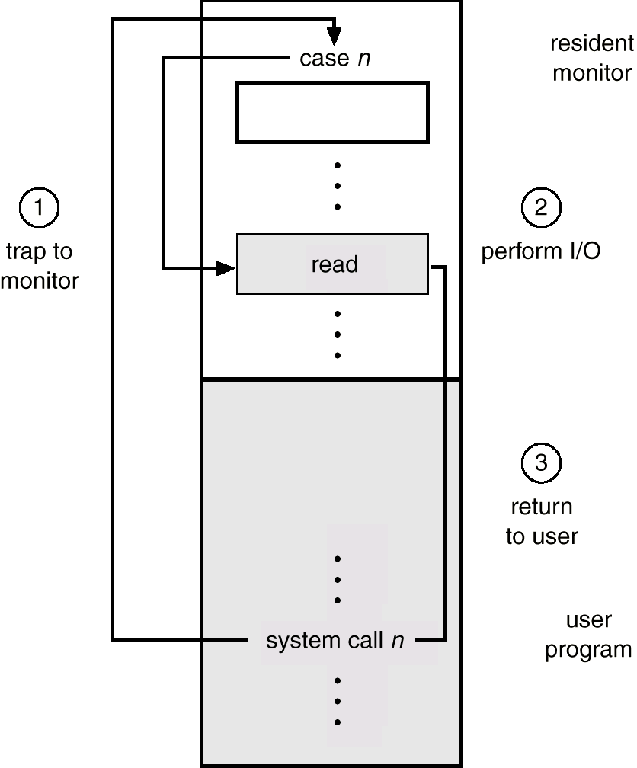
Use of A System Call to Perform I/O

